Slide 1
CS5560 Knowledge Discovery Management
Tutorial 5

Slide 2
Overview
TF-IDF (Term Frequency and Inverse Document Frequency)
Spark ML Implementation of TF-IDF
Ngrams
Spark ML Implementation of Ngram
Word2Vec
Spark ML Implementation of W2V

Slide 3
TF-IDF (Ranking Terms)
tf–idf, short for term frequency–inverse document frequency, is a numerical statistic that is intended to reflect how important a word is to a document in a collection or corpus.
We will implementing with spark ML.Feature
Spark MLlib (http://spark.apache.org/docs/latest/mllib-guide.html)

Slide 4
TF-IDF: Input
"Welcome to KDM TF_IDF Tutorial. Learn Spark ml tf_idf in today's lab.
Spark Mllib has TF-IDF.

Slide 5
TF-IDF: Output
|label| features|
+-----+--------------------+
| 0.0|(20,[2,8,13,15,17...|
| 0.1|(20,[2,3,6,7],[0....|
| 0.2|(20,[6,14,15],[0....|

Slide 6
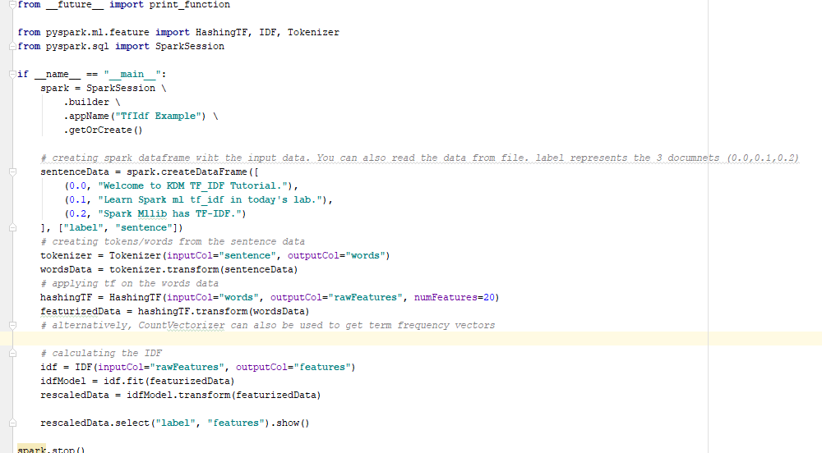
TF-IDF (Spark – MLlib) : Implementation
For implementing in Spark ML.feature; we use HashingTF and IDF functions within pyspark

Slide 7
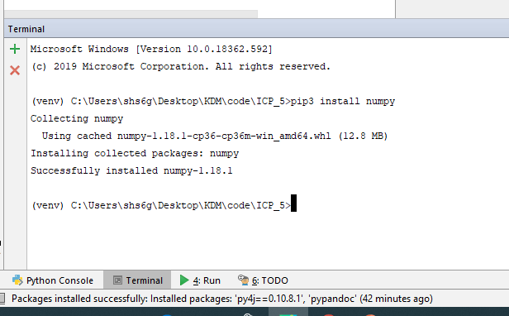
N-gram
Spark ml.feature Ngram
Hard-dependency on numpy
Need to install numpy library
pip install numpy in terminal of pycharm

Slide 8
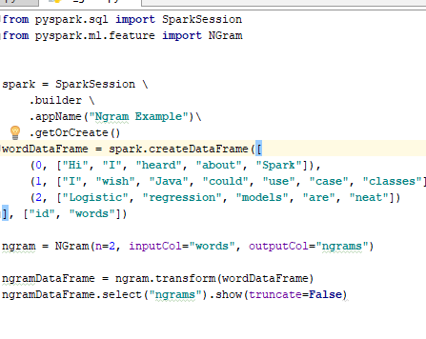
NGram
An n-gram is a sequence of n tokens (typically words) for some integer n.
The NGram function can be used to transform input features into n-grams.
NGram takes as input a sequence of strings (e.g. the output of a Tokenizer).
The output will consist of a sequence of n-grams where each n-gram is represented by a space-delimited string of n consecutive words

Slide 9
NGram Input/Output
[input,output] if n = 2
[(go, sample, text),(go sample, sample text)]
[(run, good, health),(run good, good health)]
[(computer, science, study),(computer science, science study)]

Slide 10
Word2Vec - MLlib
Word2Vec computes distributed vector representation of words. The main advantage of the distributed representations is that similar words are close in the vector space, which makes generalization to novel patterns easier and model estimation more robust.

Slide 11
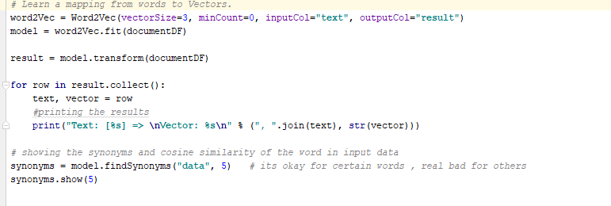
Word2Vec
Word2vec creates , model based on the input data.
Input is RDD[Seq[String]]
FindSynonyms finds the top 5 words which has closest cosine similarity with a given word say “data”

Slide 12
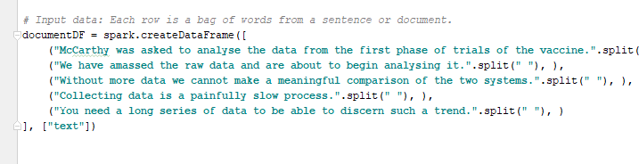
Word2Vec
INPUT
Input is text.
Word2Vec model richer with the more the data you give.
The data has to be sentence format.
Individual words or dataset doesn’t build a good model.

Slide 13
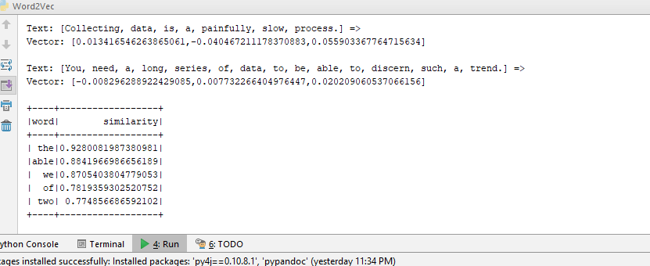
Word2Vec
OUTPUT
Output is the synonyms for a given word say “data” based on given document.
Also vector of the given words in the sentences

Slide 14
Word2Vec Workflow
TEXT
NGram
Reading into RDD
CoreNLP Lemmatization
RDD
Tokenizer
Stop Word Remover
Word2Vec
TFIDF

